Slide 1
HicknHack Software
My modern C++ journey (part 1)
Andreas Reischuck

Slide 2
Mount Coding Dojo

Slide 3
Map Lowerbound & Upperbound
std::multimap<int>
begin()
lower_bound(3)
upper_bound(3)
end()
1
2
3
3
6
7
find(2)
upper_bound(4)
find(4)

Slide 4
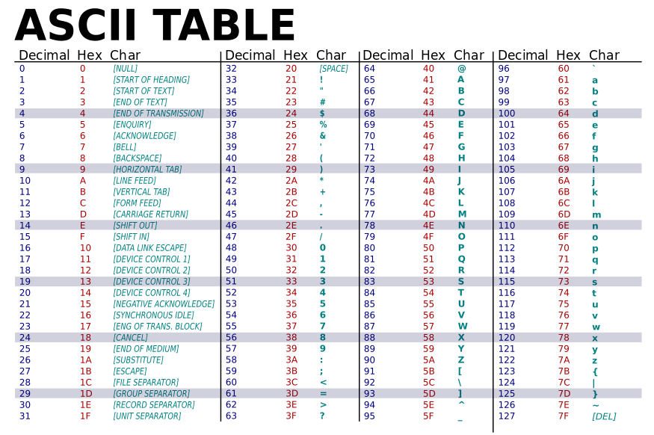
https://simple.wikipedia.org/wiki/ASCII#/media/File:ASCII-Table-wide.svg

Slide 5
Path ordering
mnt-more
mnt.txt
mnt/txt
mnt1
mntZ
mnt\txt
mnt_txt
mntz
mnt/txt
mnt\txt
mnt-more
mnt.txt
mnt1
mntZ
mnt_txt
mntz

Slide 6
PIMPL

Slide 7
Options
std::unique_ptr<Impl>
std::shared_ptr<Impl>
chained

Slide 8
Plain Class Layout
user
vtable
RC
Interface

Slide 9
Unique Pointer Memory Layout
user
vtable
RC
Interface
vtable
Implementation

Slide 10
Shared Pointer Memory Layout
user
vtable
RC
Interface
vtable
RC
Implementation

Slide 11
Chained Pimpl Memory Layout
user
RC
Interface
Implementation
vtable
vtable

Slide 12
Vector Tree

